Slide 1
Chaser 2 — Line Following, Information Gathering, and Communication
Rachel VanRyzin, Isabella Knox, 3/20/19

Slide 2
Biggest Successes
Biggest Challenges
Integration of XBee communication & sensing into one code
Installation of whisker wires
Basically had to start the wiring from scratch
Troubleshooting the code (making one Mega code is rough)
Troubleshooting the bot (why does she spazz?)

Slide 3
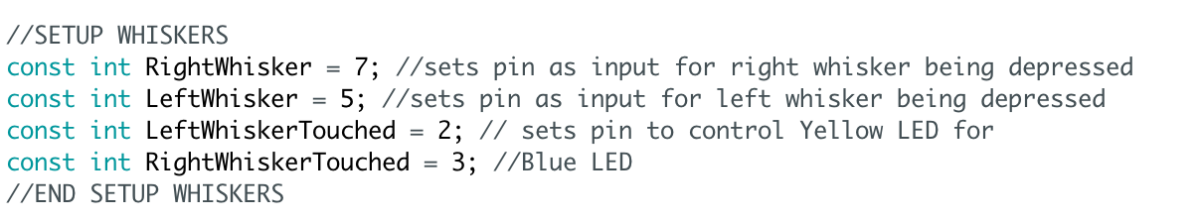
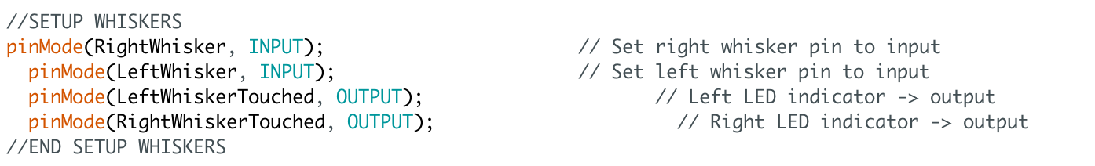
New Code
Sets up pins as inputs for when whiskers are depressed
Sets up yellow and blue LEDs to indicate that the whiskers have sensed an obstacle
Code Sourced from Parallax Activity from Lab 5

Slide 4
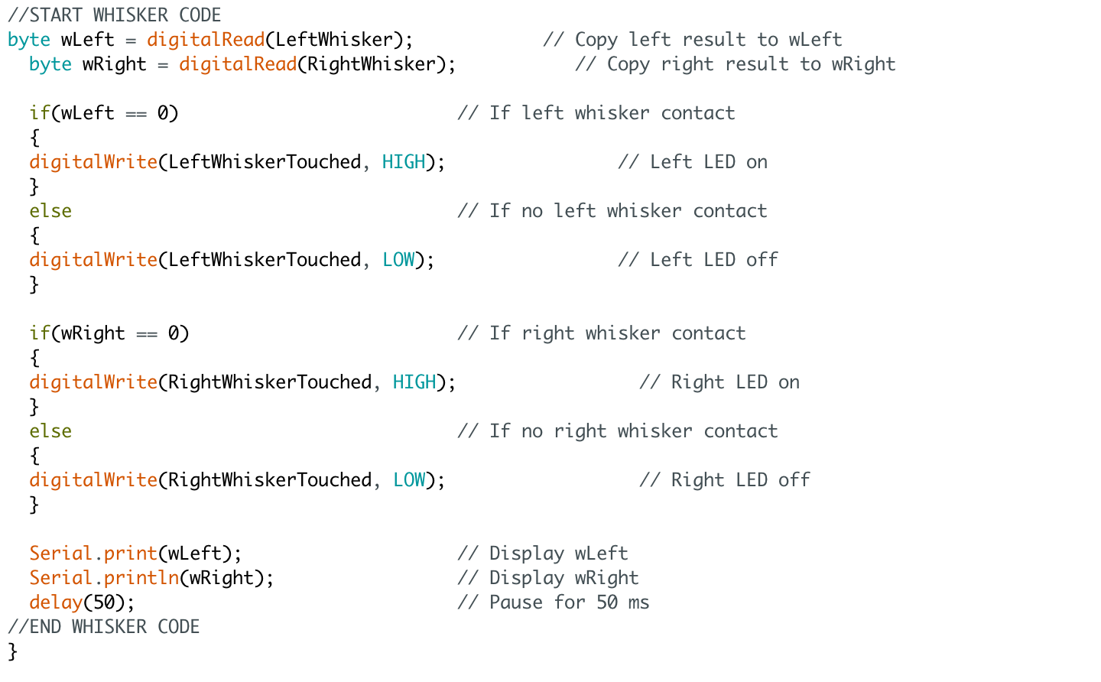
More New Code
Makes yellow and blue LEDs light up when the whiskers sense something
Makes the serial monitor print whether or not the whiskers sensed something
Code sourced from Parallax Activity from Lab 5

Slide 5
Next Week
Begin working on team communication for score sharing
Begin working on digital display for score

Slide 6
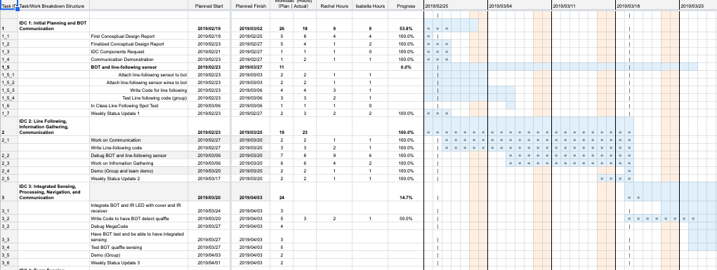
Gantt Chart

Slide 7
Cost Added This Week
Whisker Wires Circuit (added 3/16/19):
Yellow LED (1) | $0.32
Resistor, 220ᘯ (2) | $0.20
Resistor, 6.8ᘯ (1) | $0.10
Wire, ~0.5 ft | $0.04
3-pin m/m header (1) | $0.50
Line Following sensors (added 3/06/19):
QTI sensor (3) | $29.97
3 wire extenstion cable (3) | $4.32
Total Cost of parts ON bot: | $35.45
Total Cost of bot and parts: | $234.45

